Slide 1

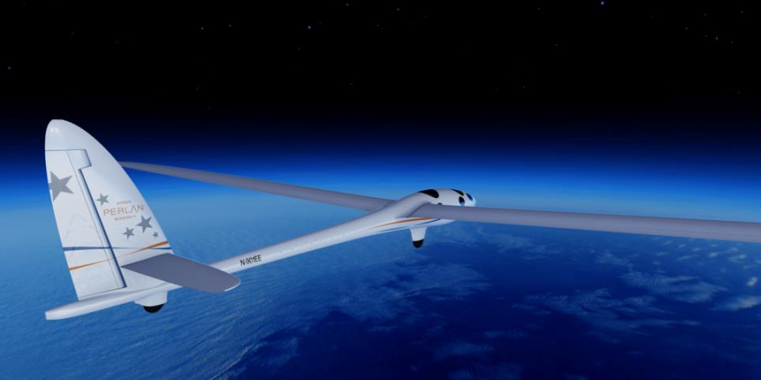

Argentina 2016

Slide 2
Media Briefing
Welcome & Introductions
  Lindsy Caballero, Airbus
Video – First Flight
Airbus Perlan Mission II – Overview
  Ed Warnock, CEO, The Perlan Project
Surfing the Sky
  Jim Payne, Chief Pilot
Perlan 2 - A Unique Design
  Morgan Sandercock, Pilot & Project Manager
Perlan 2 & The Future
  James Darcy, Airbus
Q&A

Slide 3
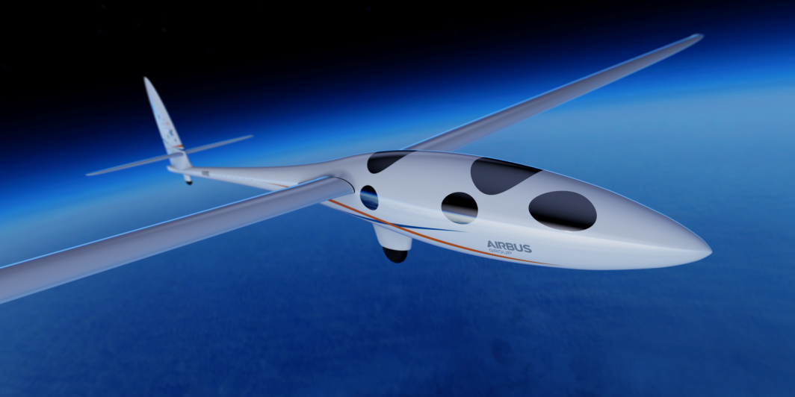


Project Overview
Ed Warnock – CEO
Soaring to the Edge of Space

Slide 4
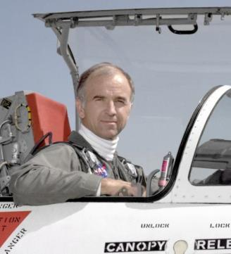
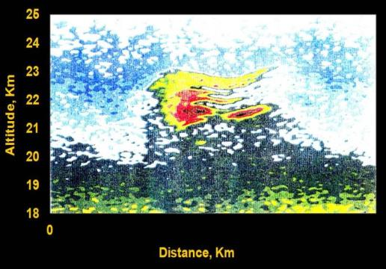
Idea that Sparked the Journey
Einar Enevoldson - Founder, The Perlan Project
Mountain PSC, Kebnekaise
Notes:
Agenda:
Video – First Flight
Airbus Perlan Mission II – Overview
Ed Warnock, CEO, The Perlan Project
Surfing the Sky
Jim Payne, Chief Pilot
The Aircraft
Morgan Sandercock, Pilot & Project Manager
The Future of Aviation & Perlan 2
Ken McKenzie, EVP, Airbus
Q&A

Slide 5
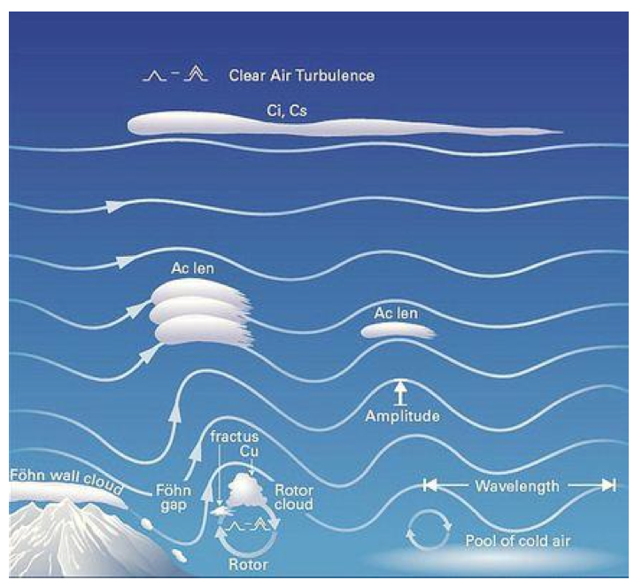
Stratospheric Mountain Waves
Notes:
Agenda:
Video – First Flight
Airbus Perlan Mission II – Overview
Ed Warnock, CEO, The Perlan Project
Surfing the Sky
Jim Payne, Chief Pilot
The Aircraft
Morgan Sandercock, Pilot & Project Manager
The Future of Aviation & Perlan 2
Ken McKenzie, EVP, Airbus
Q&A

Slide 6
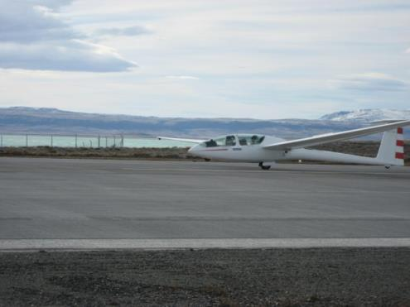
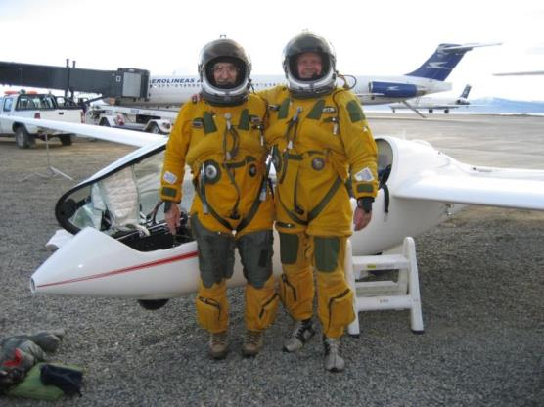
Mission I – Concept provedin
August 29, 2006
Perlan I glider
El Calafate
Einar Enevoldson
Steve Fossett
15,460 meters
Set the new world record for glider altitude

Slide 7

Project at High Level

Slide 8






Project Goals
Aeronautical Exploration
Aerodynamic Advancement
Meteorological Research
Education and Inspiration

Slide 9
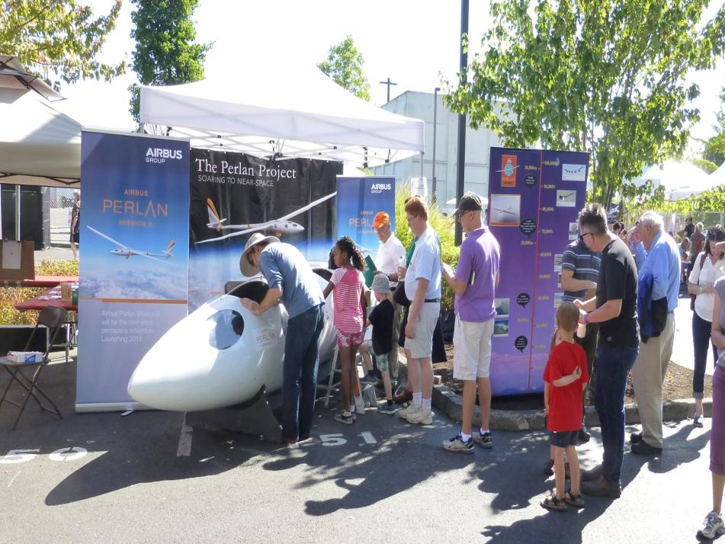
Education and Inspiration

Slide 10

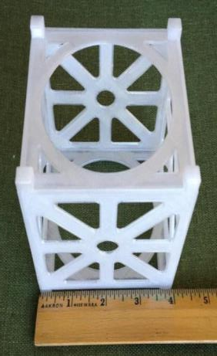
CubeSat Experiments

Slide 11
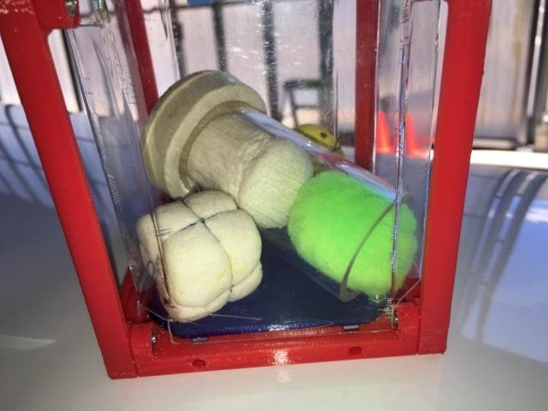
CubeSat Experiments

Slide 12
Surfing the Sky
Jim Payne – Chief Pilot
Soaring to the Edge of Space

Slide 13
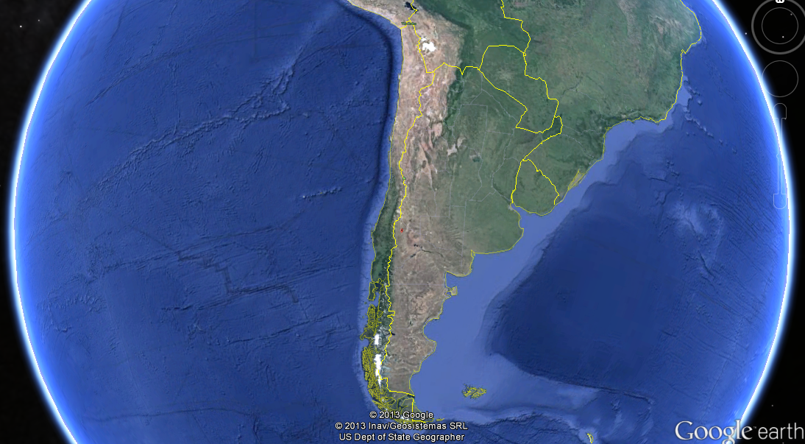
Easterlies
Big Picture
Westerlies
Notes:
Overview of weather patterns.

Slide 14
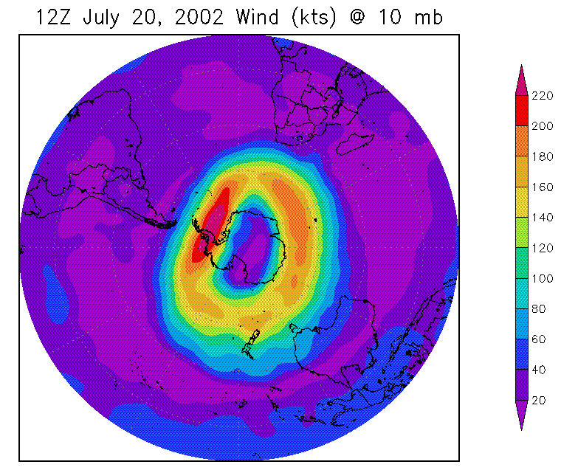
The Polar Vortex

Slide 15
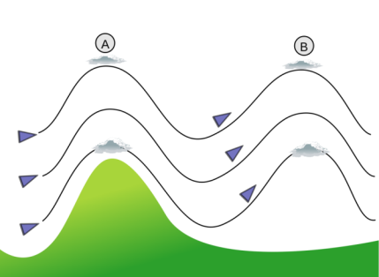
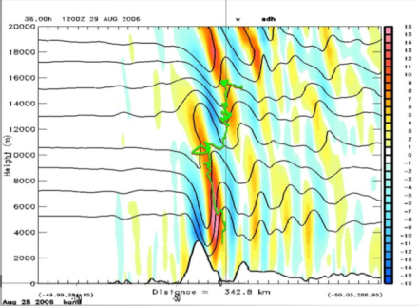
Surfing Mountain Waves
El Calafate

Slide 16
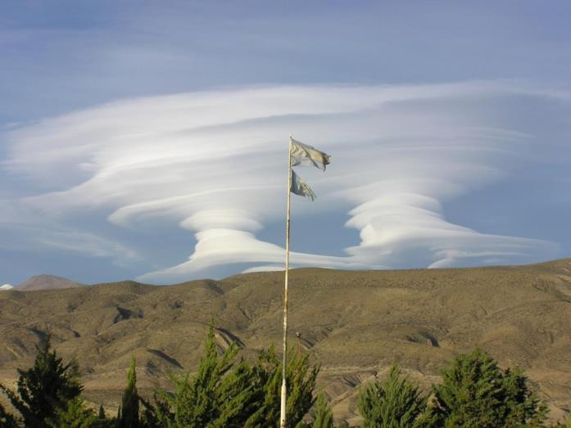
Surfing Mountain Waves

Slide 17
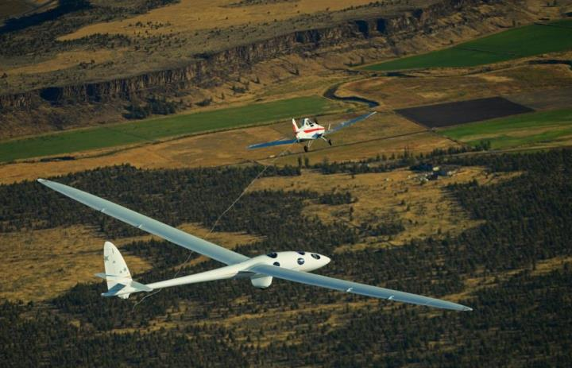
First Flight
September 23, 2015 - Redmond, Oregon, USA
Jim Payne and Morgan Sandercock

Slide 18
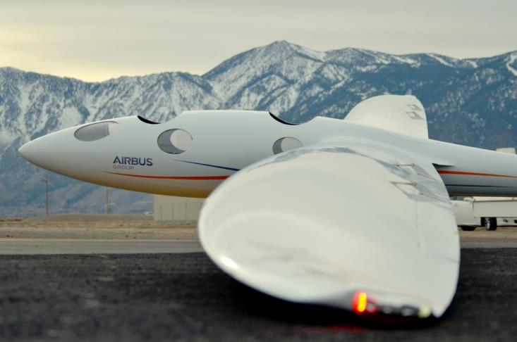
Flight Testing in Minden

Slide 19
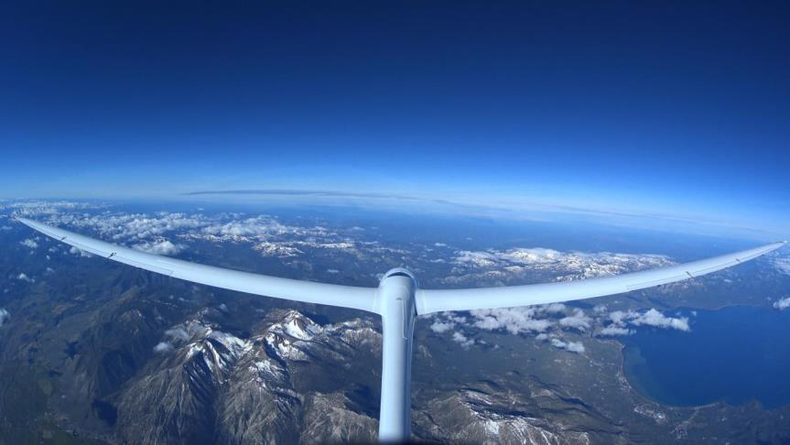
Wave Flight at 26,000 Feet

Slide 20

Apoyo en Argentina
Administracion Nacional de Aviación Civil
Aero Club Lago Argentino
Centro Nacional de Vuelo a Vela de Montaña
Empresa Argentina de Navegación Aérea
Fuerza Aérea Argentina
Laviasa
…y todos los amigos de Perlan

Slide 21
Perlan 2 – A Unique Design
Morgan Sandercock – Pilot & Project Manager
Soaring to the Edge of Space

Slide 22
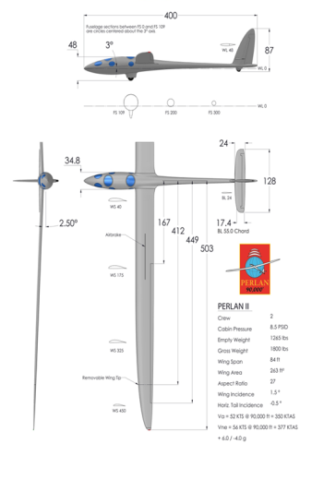
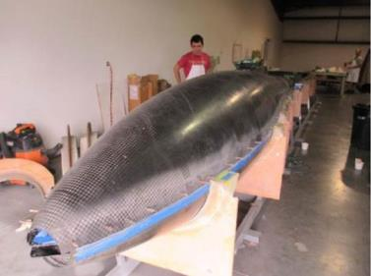
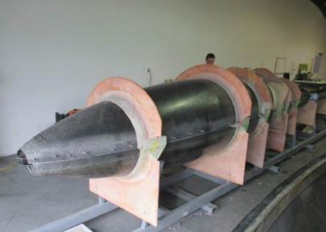
Design and Build

Slide 23
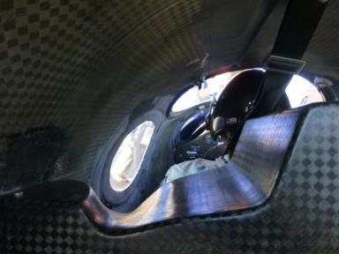
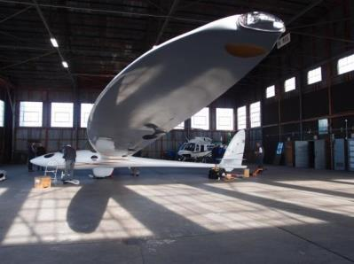
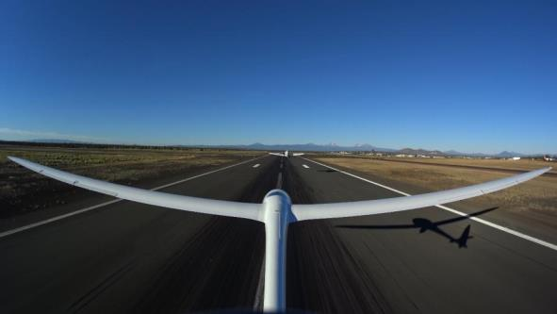
First Flight – Redmond Oregon
Sept 23 2015
Notes:
Mention 3g and 5g load tests

Slide 24
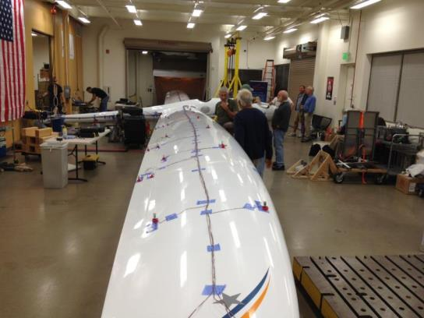
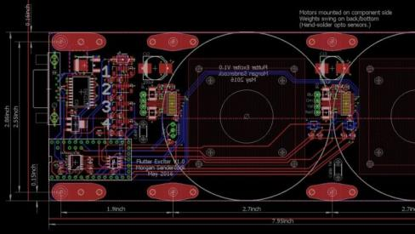
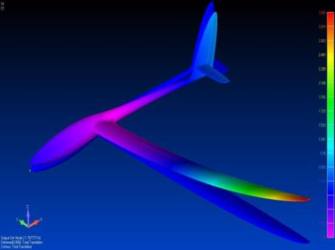
Ground Vibration Testing
Image from Flutter Model
Notes:
Mention 3g and 5g load tests

Slide 25
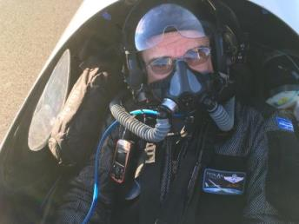
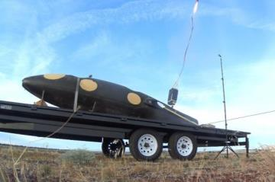
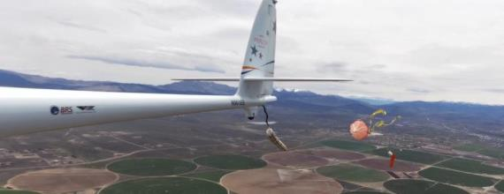
Life Support & Safety
Biomarine Rebreather
Tail Parachute
BRS Parachute

Slide 26
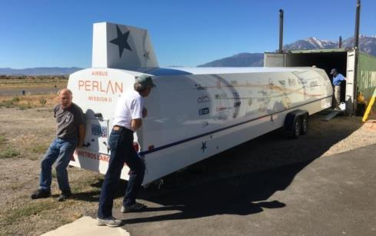
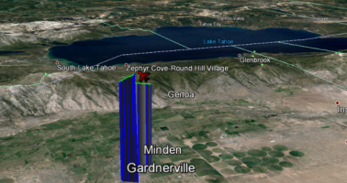
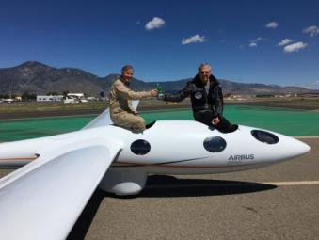
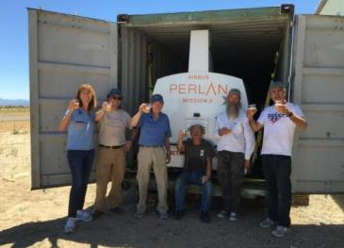
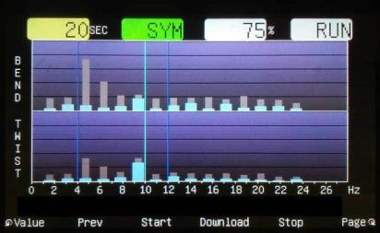
USA Testing Completed
26,000ft - June 26 2016

Slide 27
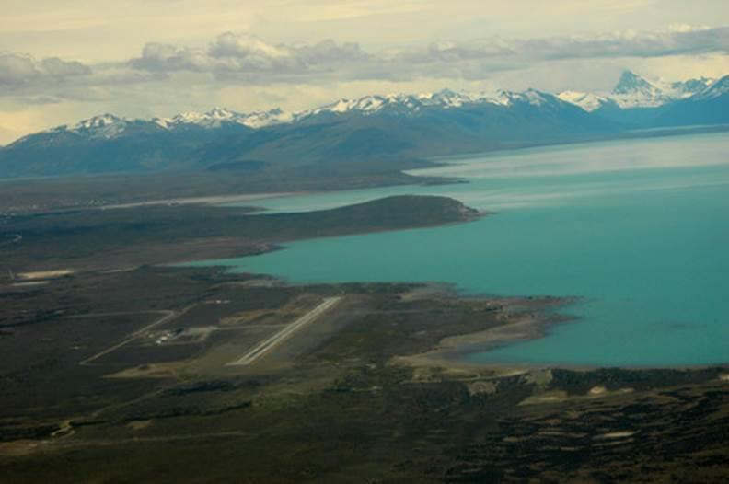
Next stop… El Calafate…
Foto: Jose Cazenave

Slide 28
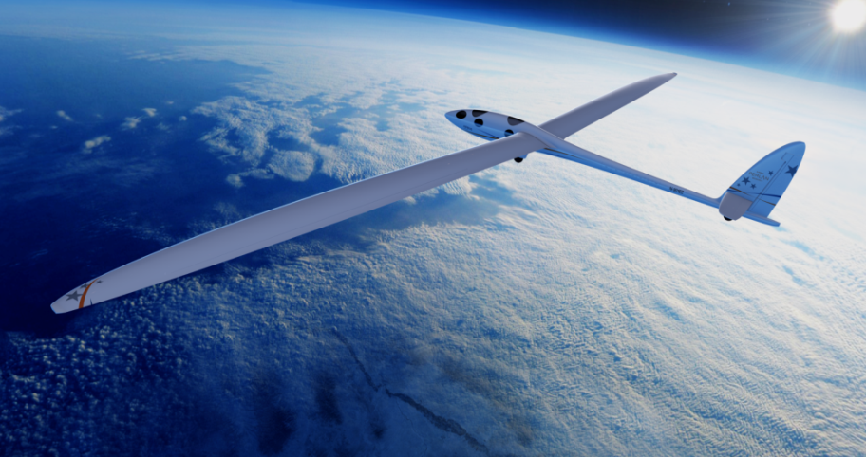
…and the stratosphere!
Standard copy introduction with bullet point content / Arial Regular 15 pt
  Bullet point list item / Arial Regular 15 pt
    Second level bullet list / Arial Regular 15 pt
    Second level bullet list / Arial Regular 15 pt

Slide 29
Perlan 2 & Future of Aerospace
James Darcy – Airbus Group
Soaring to the Edge of Space

Slide 30

Perlan 2 & The Future
Aerospace innovations
  How and where do we need to fly next?

Slide 31

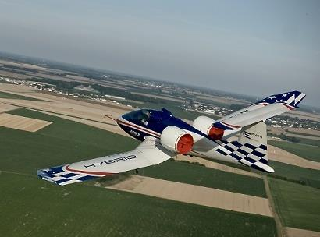
Perlan 2 & The Future
Creating a better world

Slide 32
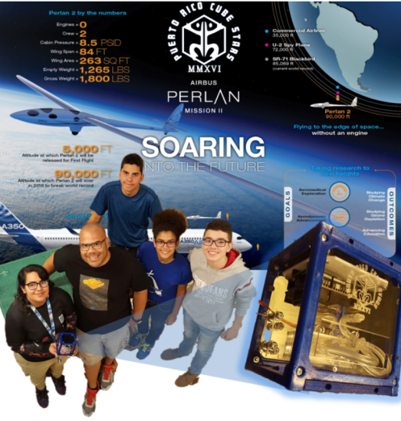
Perlan 2 & The Future
Inspiring the next generation

Slide 33

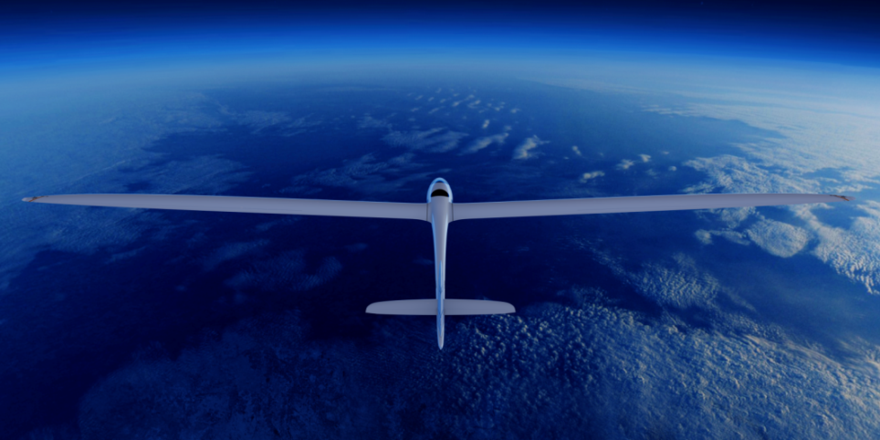
Questions?

Slide 34
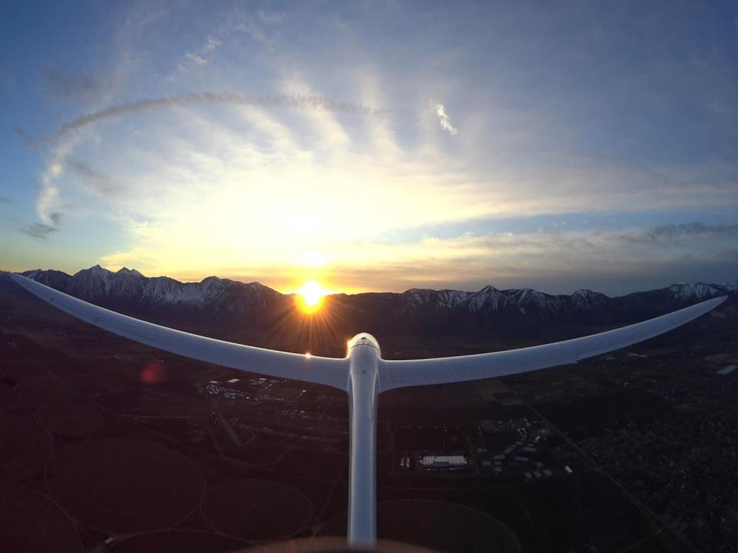
Greetings from El Calafate!
PerlanProject.org
Airbusgroup.com/Perlan
@PerlanProject
#PerlanPostcards
Argentina
2016

